Slide 1
Acoustic Sources in UAVs

Slide 2
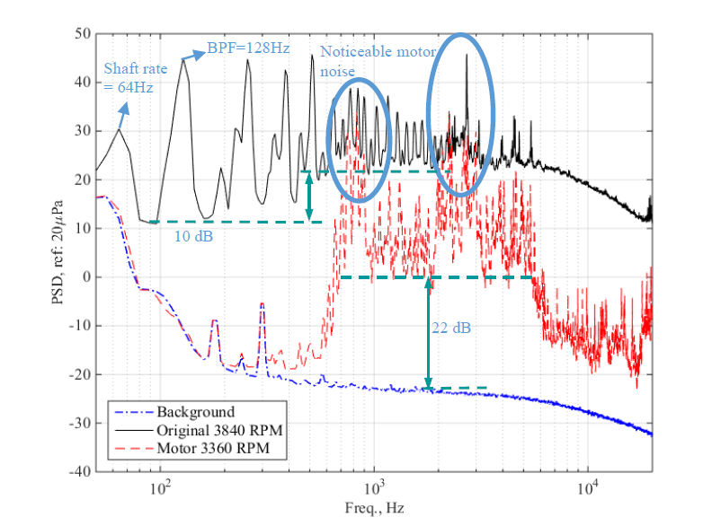
Characteristics of the Acoustic Spectrum of a Multirotor Aircraft
Tonal noise (rotational noise) at harmonics of the blade-passage frequency due to unsteady loading, ‘thickness’ noise, laminar-vortex shedding, blade-vortex interactions, etc.
Broadband noise (vortex noise) due to wake turbulence, trailing-edge and tip vortices, blade-wake interactions, laminar separation bubbles, etc.
Source: https://doi.org/10.2514/6.2016-2873

Slide 3
Comparison of Scales
Full-scale Helicopters –
Re – O(1e6) BPF – O(10Hz)
Small-scale multicopter –
Re – O(1e4-5) BPF – O(100Hz)
Due to lower Re and blade-tip speeds, broadband self-noise due to laminar-transitional flow features become important in drones.
Since the rotors rotate at a higher RPM in smaller drones, rotational noise is at a higher frequency.

Slide 4
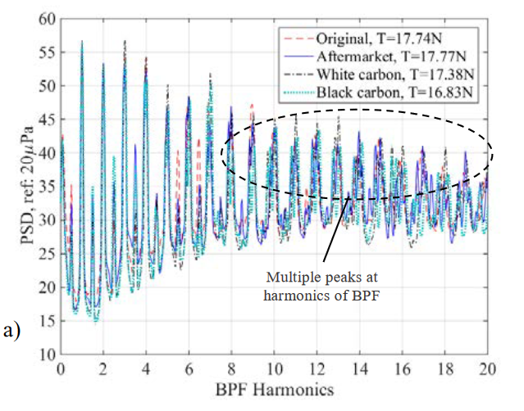
Rotational Noise – Frequency
For a rotor with 2 blades rotating at 5000 rpm, BPF = 5000/60*2 = 167 Hz.
Visible peaks at the first few harmonics of the BPF lying in the low-frequency audible region, which can be useful for acoustic detection.
Source: https://doi.org/10.2514/6.2016-2873
.

Slide 5
Rotational Noise – Mechanisms
Mechanism 1: Unsteady loading exerted by the blades on the fluid due to their rotation.
This can be predicted by the dipole term in FW-H equations.
Mechanism 2: Displacement of the fluid due to rotation of the blades.
This can be predicted by the monopole term in FW-H equations.
Mechanism 3: Unsteady pressure fluctuations on the rotor blade due to interactions with vortices generated by previous blades (Blade-Vortex Interaction). Loud and impulsive in nature, dominant at the higher harmonics of the BPF. Aeroelastic effects become important due to the large amplitudes of pressure fluctuations.

Slide 6
Broadband Noise
Unlike in helicopters, due to the low tip Mach numbers, broadband noise contributes significantly to the overall acoustic signature in UAVs.
Dominant at high frequencies of O(10kHz).
Mechanism 1: Formation and shedding of vortices in the flow past the blade.
Mechanism 2: Blade interactions with turbulence in the wake formed by the previous blades or in the free atmosphere.
Mechanism 3: Scattering of turbulent flow over the blade trailing edge (rotor self-noise).

